Slide 1
Thermostat Filtering for Anticipation
Dave Gutz 28-Jan-2016

Slide 2
Simulink Model howard_lin_r2013a_20160129

Slide 3
howard_lin_r2013a_20160129

Slide 4
howard_lin_r2013a_20160129

Slide 5
Callback Contents
Ta0=Temp;
Tw0 = (Ta0*Ha + OAT*Ho)/(Ho+Ha);
Tb0=max(min(interp1([Rn Rx],[Tn Tx],OAT), Tn),Tx);
Tc0 = ((Ha+Hc)*Ta0 - Ha*Tw0) / Hc;
D0 =max(min( Hc*(Tc0-Ta0)/(Hf*(Tb0-Tc0)), 1), 1e-32);
Ta1=SET(1,2);
Tw1 = (Ta1*Ha + OAT*Ho)/(Ho+Ha);
Tb1=max(min(interp1([Rn Rx],[Tn Tx],OAT), Tn),Tx);
Tc1 = ((Ha+Hc)*Ta1 - Ha*Tw1) / Hc;
D1 =max(min( Hc*(Tc1-Ta1)/(Hf*(Tb1-Tc1)), 1), 1e-32);
% Note: not steady state at initialization
if D0>D1
DUTY0 = 0;
% Used by thermostat
intEi = max(min(D0*(Tb0-Tc0)*Hf/.005, 1), 0);
% Needed to balance model
intEi = max(min(otherHeat(1,2)/.005, 1), 0);
else
DUTY0 = D1;
intEi = 0;
end
OAT=30;
Temp=68;
Rn=29;
Rx=69;
Tn=180;
Tx=120;
Hc=114/86400;
Ha=1.61/86400;
%Hf=1.08/86400;
Hf=1.745/86400;
Ho=283/86400;
tau=40;
FILTER_DELAY = 5;
Kv=400; % gain in TCOMP of house control
Kei=2e-4;
Kep=1;
% From match to thermo20160128.xlsx
sNoise=0.001;
SET = [0 60 18861 18862; 68 62 68 68]';
otherHeat=[0 1000 6000; .001 .001 .0005]';
tFinal = 24132;
Temp= 68.98;

Slide 6
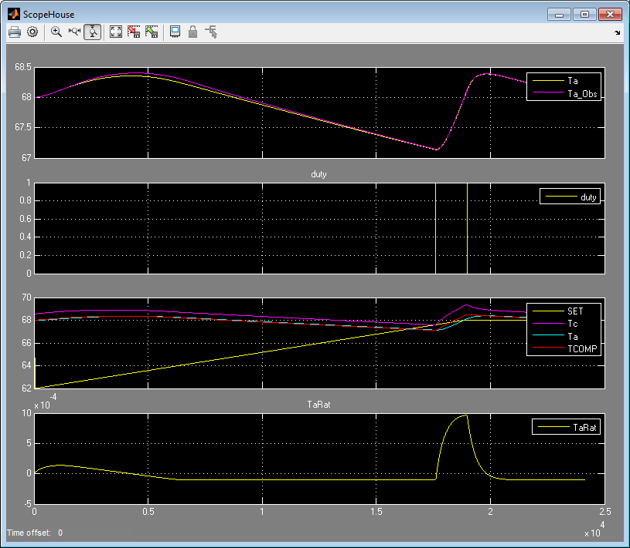

Slide 7
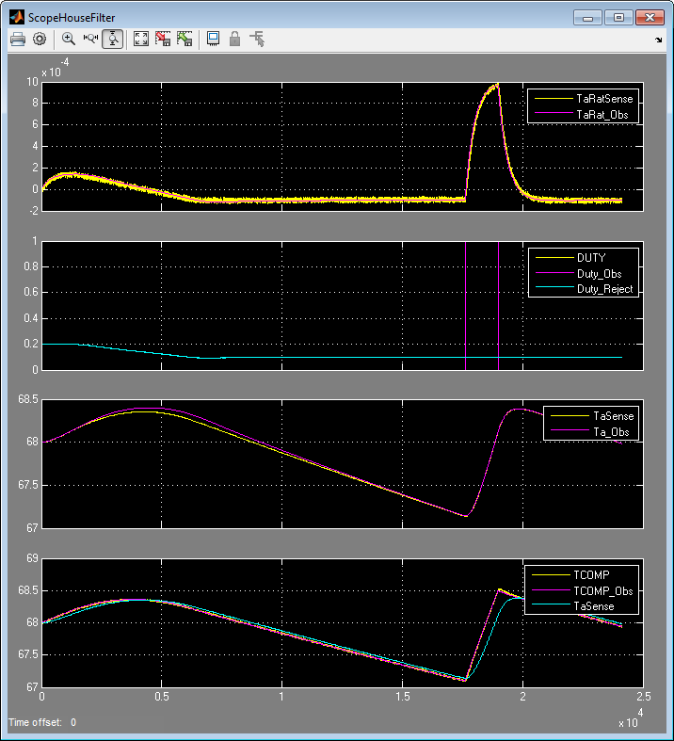

Slide 8
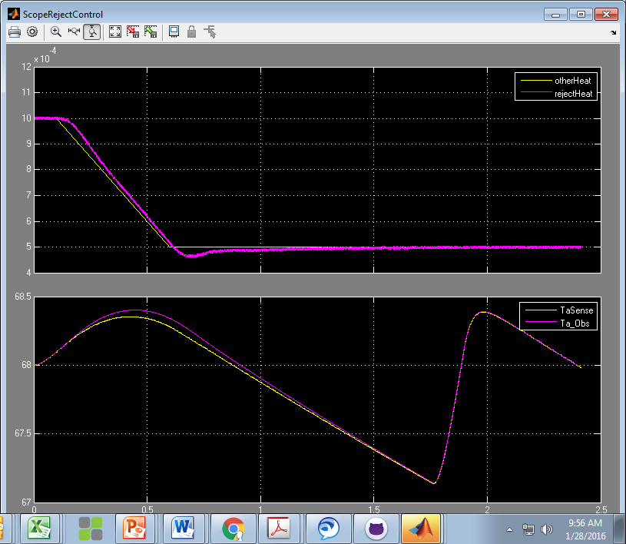

Slide 9
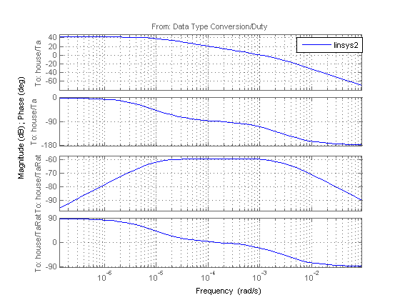
8e-6 r/s
3e-3 r/s

